Slide 1
ELLIOT BLADEN
Website Proposal
T1A2
Launch 05/09/21

Slide 2
CONTENTS OF SLIDE
About me and the project
Project Theme and Design
Project Features
Project Review

Slide 3
01
02
THE
PROJECT
PROJECT THEME/DESIGN
TABLE OF CONTENT
03
04
PROJECT CODE AND FEATURES
REVIEW
Basic details of the website
What is the project trying to accomplish and how was this done
Insight on how certain attributes where achieved in maintaining its congruence with the theme
Challenges, fav parts and lessons learnt

Slide 4
01.
ABOUT THE PROJECT
The website in its basic component is an introduction to myself. Its a display of my professional talents aswell as showcasing myself away from work. In other words a fancy Resume. The website is broken down into 4 pages. The home page being page 1. The about me page . The blog page and the resume pages.

Slide 5
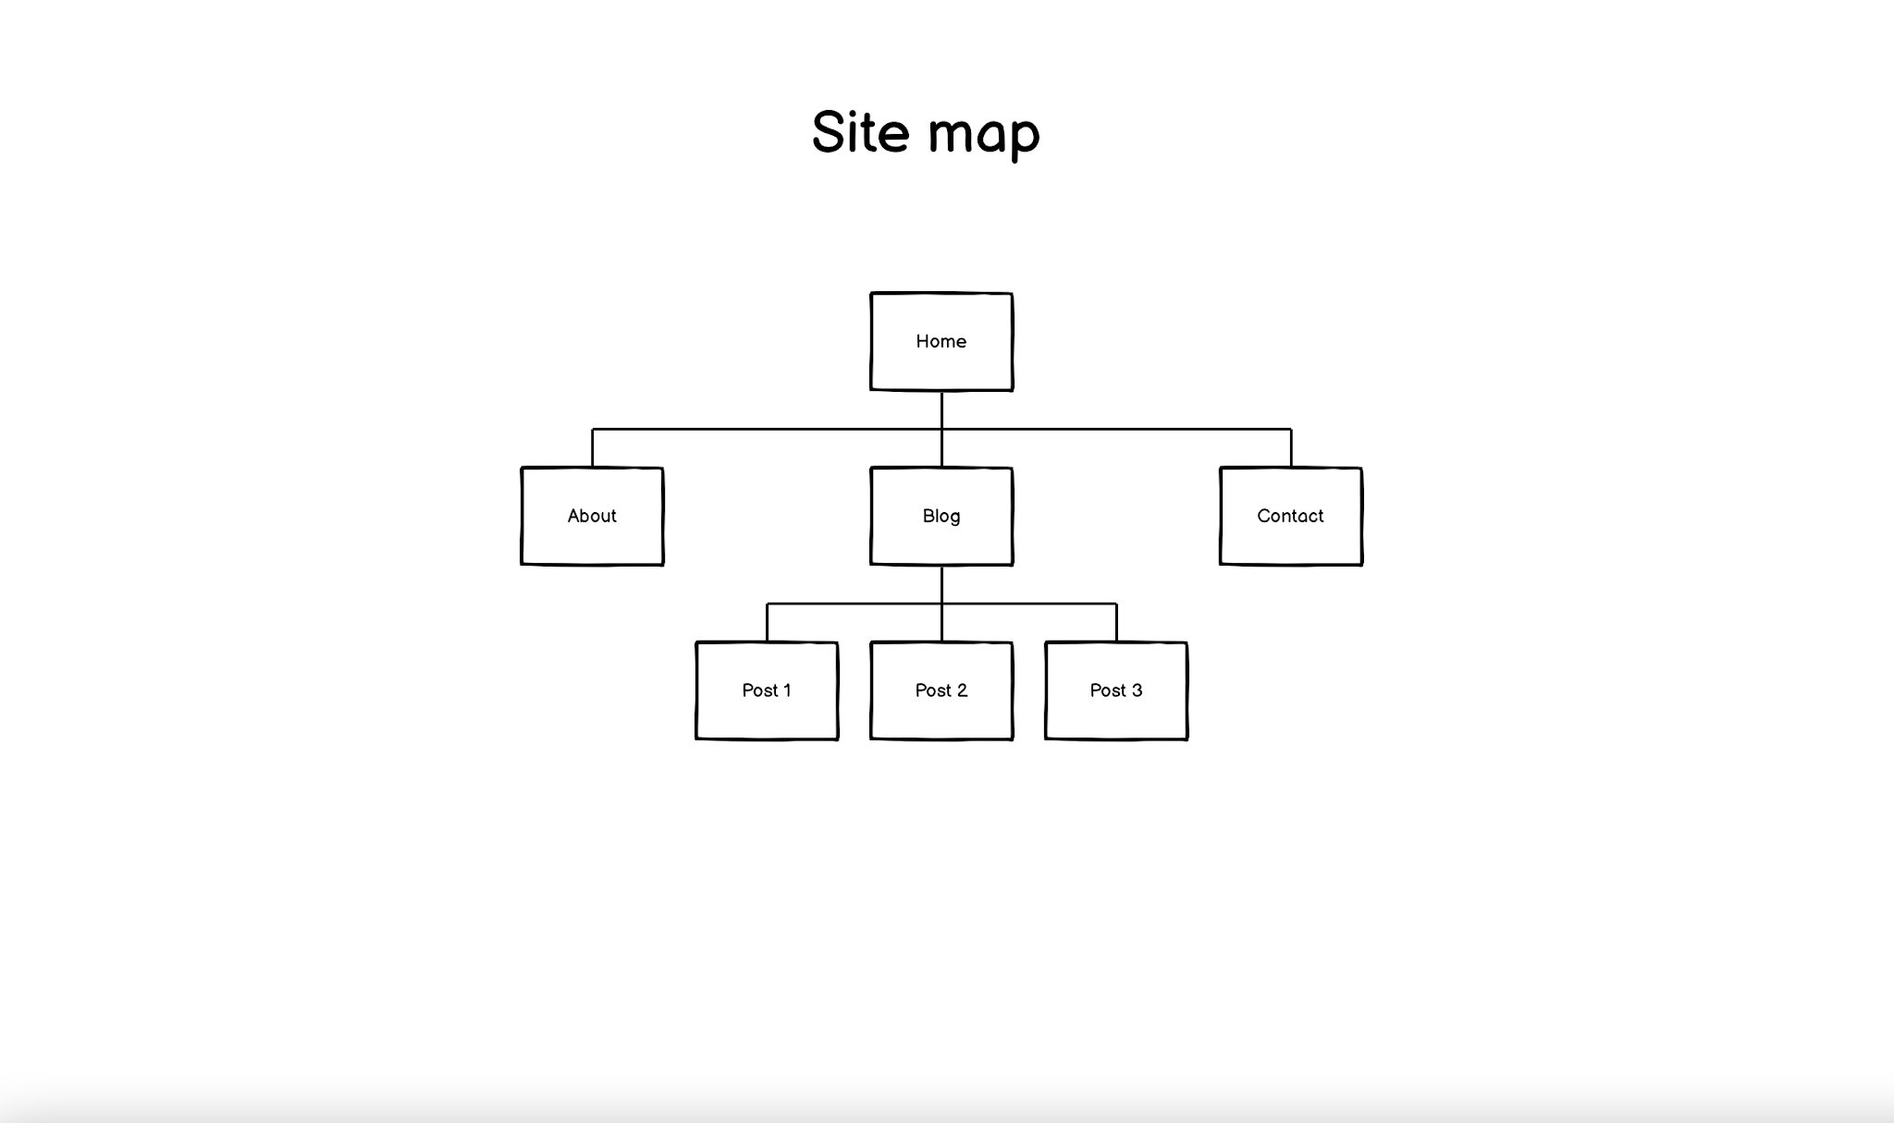

Slide 6
Home Page (Page 1)
About me (Page 2)
WEBSITE LAYOUT
Blog (Page 3)
Resume (Page 4)
Home page. The main page. An Introduction to myself and a easy accessible page to get to other areas of the website. Professional layout and easy on the eye
A little about myself so the viewer knows who I am. Nothing long so the reader won’t bore. An easier to use Nav bar for easy accessibility
A more personal revealing of myself. This webpage is the most advanced. Gives the viewer a more detailed look into my personality.
The most simplistic of all the webpages. Professional theme. An easier to navigate webpage. Gives the viewer the chance to download my professional history.

Slide 7
02.
PROJECT THEME AND LAYOUT
Elliot Bladen Website

Slide 8
PROJECT THEME AND DESIGN
The number one theme the website aims to achieve is simplicity. Simplicity in its design. Simplicity in its layout and simplicity in its features. The website demonstrates the creators websites ability and showcases future potential growth.
The other themes that have been implemented into the project is Flex box design and also Mobile friendly accessibility. The former being the more easier to create and the later being a necessity in todays website market
The color them is blue black and white. Gives a techy feel whilst still maintain professionalism

Slide 9
HOME PAGE
The home page aswell as the blog page is the most professional of the lot. Homepage being the most important is where I tried to achieve to catch the viewers attention. The nav bar is simple and clearly displayed.
The contents created through flexbox gives the viewer a taste of what the website has to offer while the footer gives the reader a chance to connect through various forms of social media.
Clear, simple to the point.

Slide 10
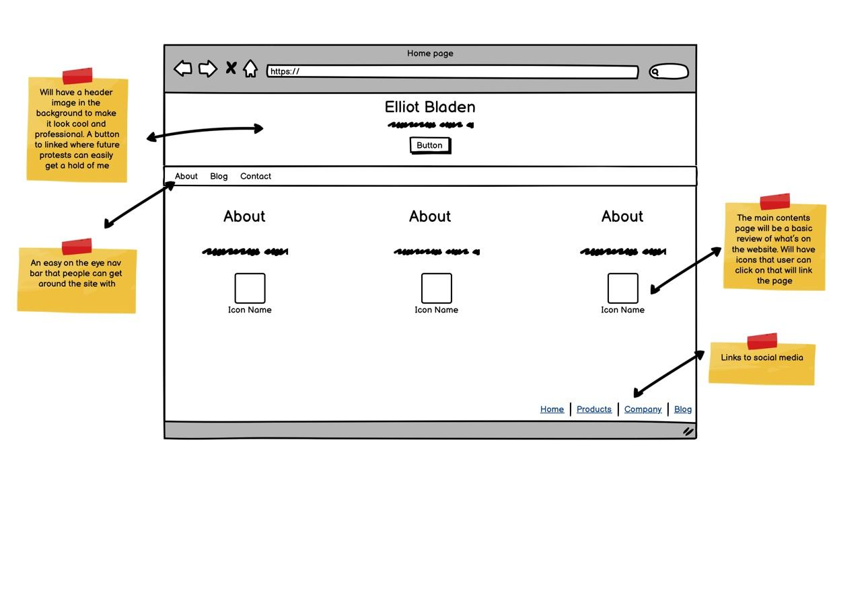

Slide 11
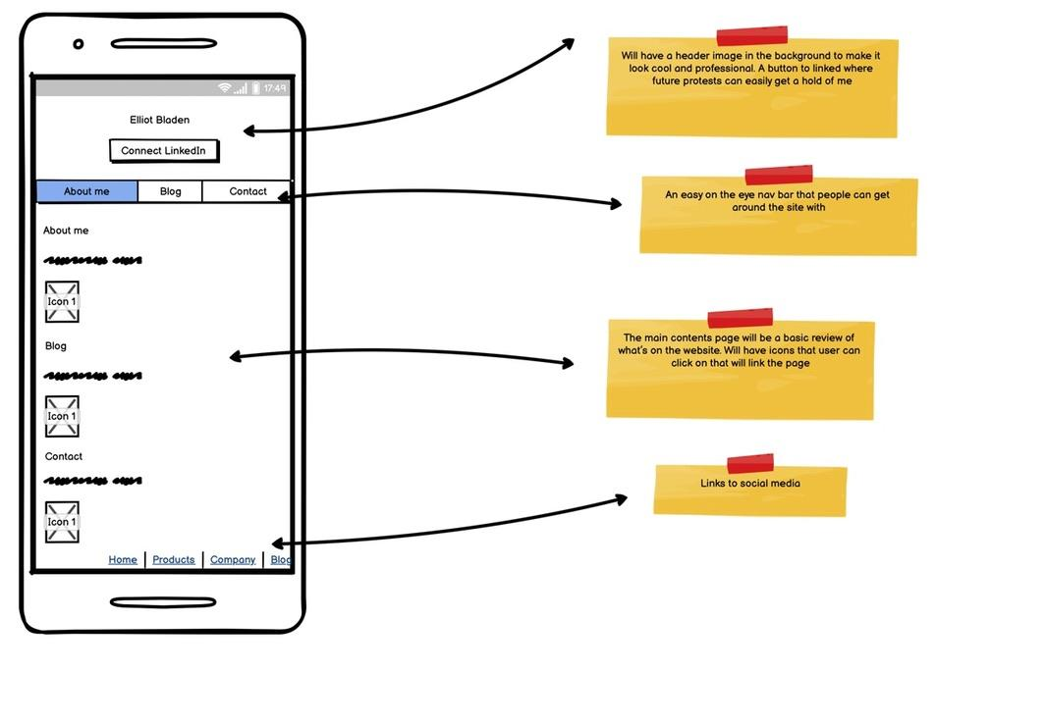

Slide 12
AB0UT ME
The most simplistic page on the site. The page now is rid of the header to give a more clean feel. Nav bar, contents, footer. Flexbox design to give a simple fee and easier read via mobile and tablet

Slide 13
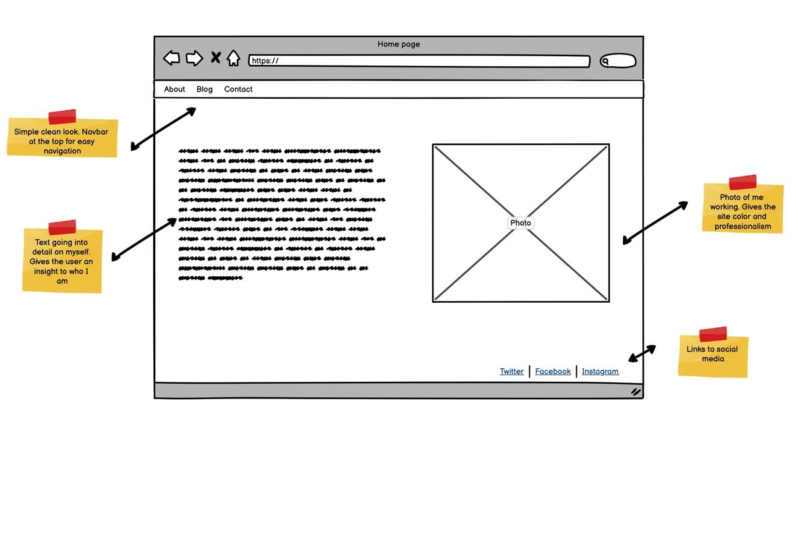

Slide 14
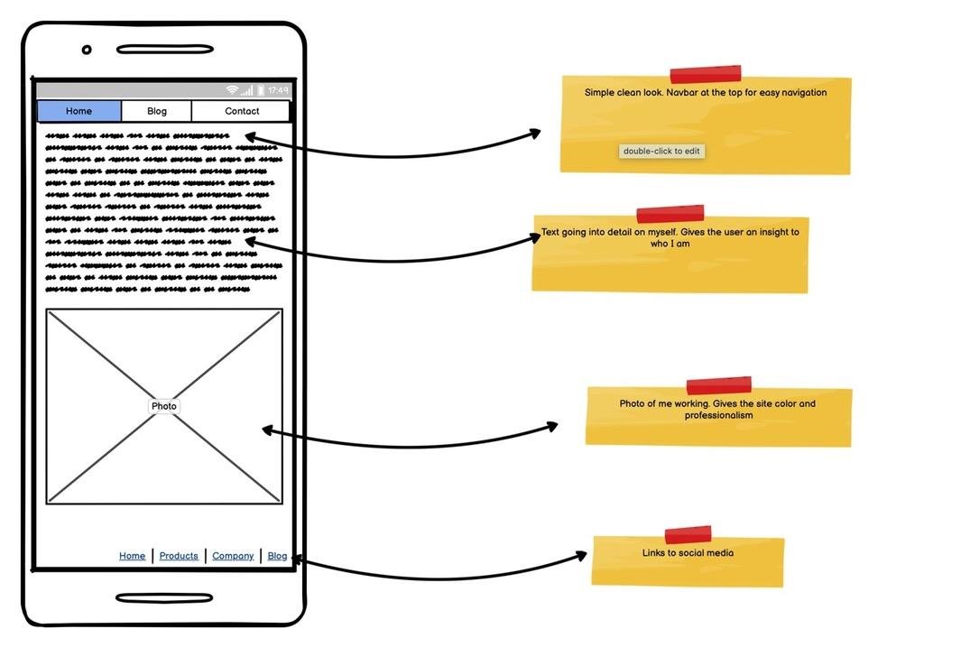

Slide 15
BLOG
The most complex page out of the lote. Still very simplistic and slick. Mobile and Tablet kept in mind while designing

Slide 16
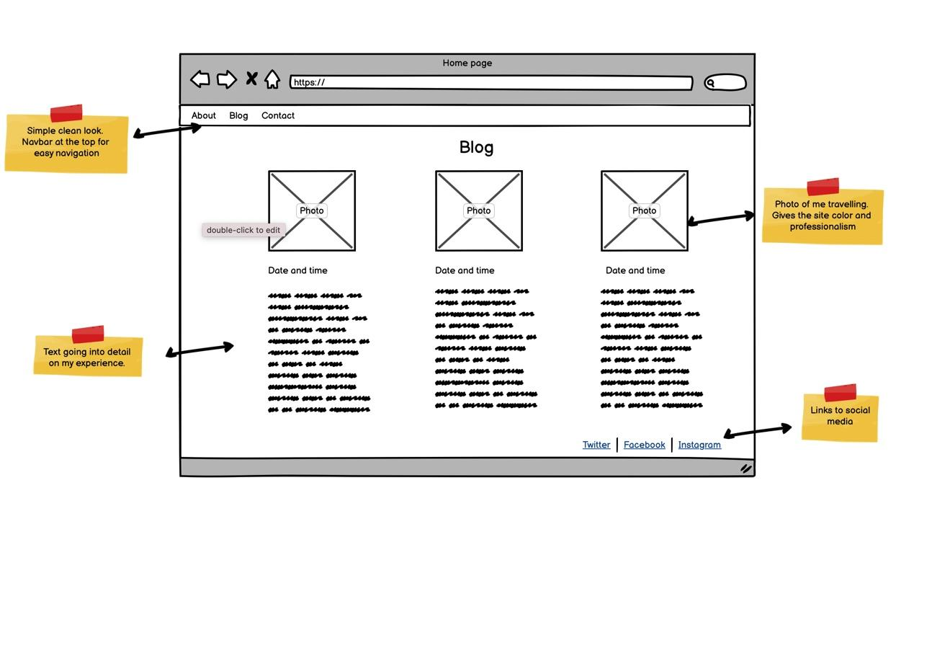

Slide 17
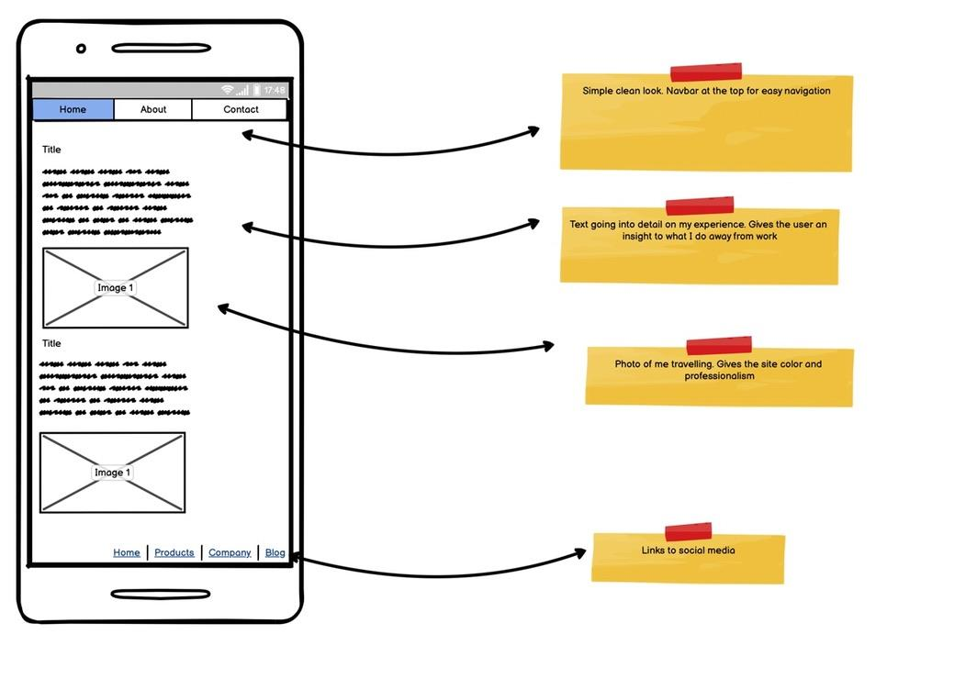

Slide 18
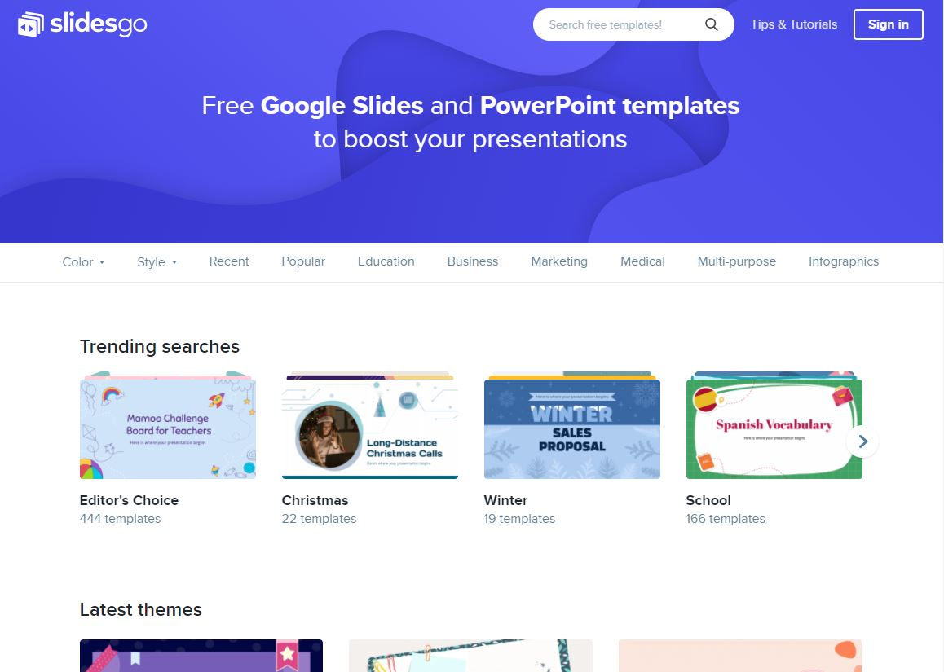
RESUME
Contact Page. Simple and easy understand page

Slide 19
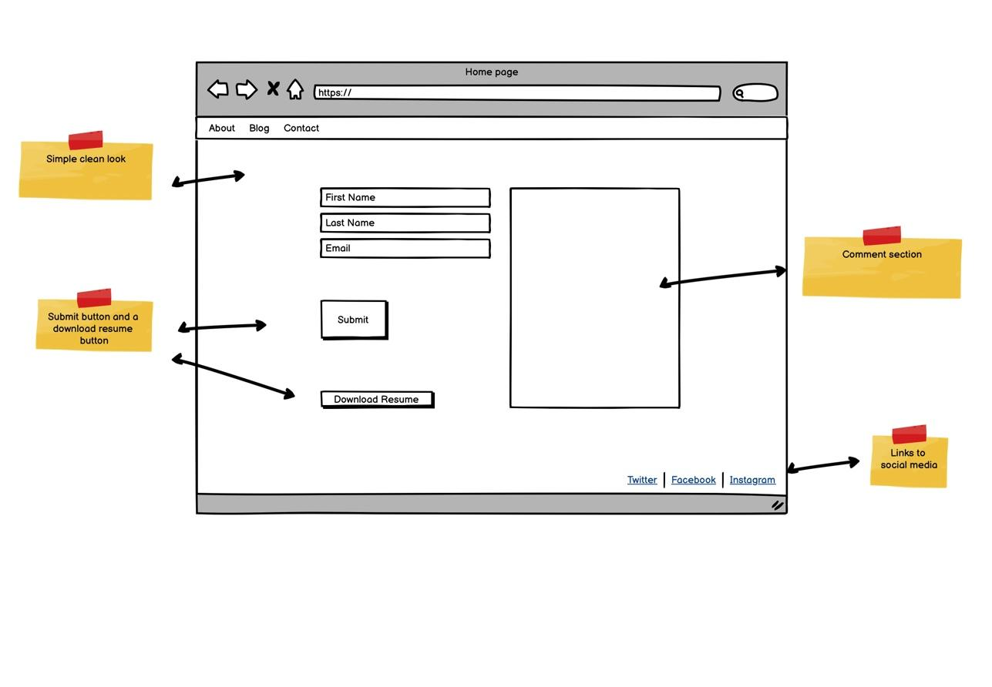

Slide 20
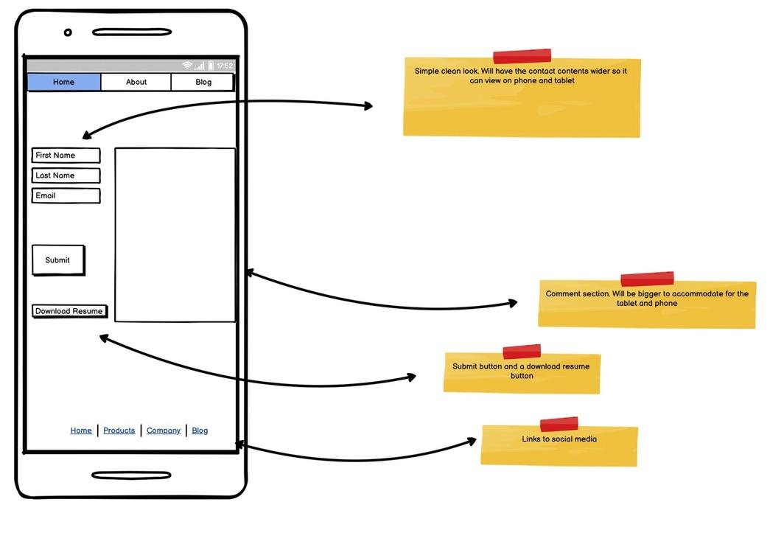

Slide 21
02.
PROJECT CODE AND FEATURES
Website Development Site.

Slide 22

FEATURES OF THE HOMEPAGE
HOME PAGE
4 main features of the home page
The LinkedIn connect button. The main feature of the website and inserted into an area that has a professional layout.
The Navbar. This was the only feature not using flexbox. I wanted to the page to stand out and give the user an easy navigation into other areas of the site
The footer Navbar. This was created as a flex design in CSS. An important part of the page in giving the user a chance to connect socially.
Icons included to give a more professional look

Slide 23
FEATURES OF THE ABOUT PAGE
ABOUT PAGE
The first page where the viewer experiences simplicity.
The main feature being the contents of the site which gives the viewer an easy read and a chance to move to other pages of the site. Flex box creation giving the page distance and continuity.
Nav bar for easy accessibility

Slide 24
FEATURES OF THE BLOG PAGE
BLOG PAGE
IThe blog will be constructed using 3 flex box columns. This will maximise the contect on the page. This flex back to rows going into a mobile mode.
3 photos to make the web page look good
Nav bar inserted to move in around the site
Links included to a more detailed blog post

Slide 25
FEATURES OF THE CONTACTS PAGE
RESUME PAGE
Created in HTML. Flex box feature in CSS to give the reader usability on mobile and tablet devices

Slide 26
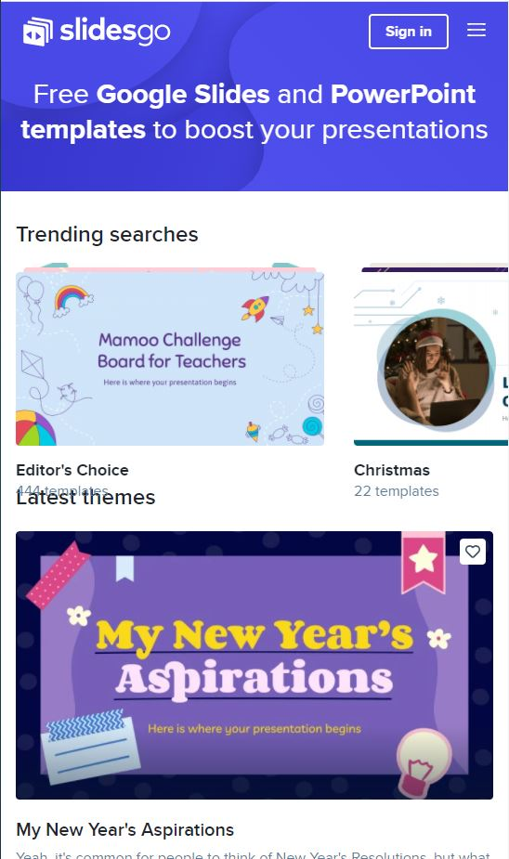
PHONE USABILITY
All pages were designed to be Mobile user friendly. This was done by using 2 features
Flexbox
CSS code using media width

Slide 27
04.
PROJECT REVIEW
Website Development Site.

Slide 28
REVIEW
Challenges
Getting started from scratch and trying to get a grasp on CSS flex
Getting HTML and CSS to talk and figuring out why things do certain things
Working out CSS border, margins, paddings
Lessons Learnt
A clear strategy at the start
Not to rush things and try to conceptualise items of design before making decisions

